Slide 1
RESPONSE CACHING IN ASP.NET CORE

Slide 2
What is Response Caching?
Response caching reduces the number of requests a client or proxy makes to a web server. Response caching also reduces the amount of work the web server performs to generate a response.

Slide 3
Why we use Response Caching?
Can improve performance and scalability.
Caching improves and speeds up browsing.
Retrieving files from your hard drive will always be faster than retrieving them from a remote server, no matter how fast your Internet connection.

Slide 4
ResponseCache Attributes
The ResponseCache attribute can be applied both to actions (methods) as well as controllers (classes).
GET requests are cacheable. POST requests are not cacheable by default but can be made cacheable if either an Expires header
Duration
The maximum duration (in seconds) the response should be cached.
Required unless NoStore is true.
Location
The location where the response may be cached. May be Any, None, or Client. Default is Any.
VaryByHeader
When set, a vary response header will be written with the response.

Slide 5
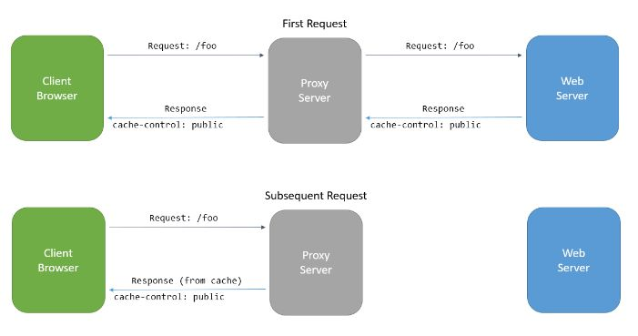

Slide 6
Common cache-control directives:
Public
Indicates that a cache can store the response either at the client-side or at a shared location.
Private
Indicates that only a private cache on the client-side may store the response,
but not a shared cache.
No-cache
Specifies that a cache must not use a stored response for any requests.
No-store
Indicates that a cache must not store the response.

Slide 7
THANK YOU !!

